Slide 1


Team 4 - Virtual Queue
ECE477 MIDTERM
DESIGN REVIEW

Slide 2
OUTLINE
Project Overview
Block Diagram
Major Components
Packaging Design
Electrical Schematic
PCB Layout
Prototyping Progress
Software Development Status
Project Timeline
Questions

Slide 3


PROJECT OVERVIEW
Virtual Queue
Virtual Queue aims to eliminate lines from capacity-limited businesses
Provides a physical, touchless station outside entrances/exits to ensure customers are present to join the queue and later enter the business

Slide 4
PSSCS
An ability to send queue management commands to a WiFi module via UART.
An ability to update the display to show current queue information including the number of people inside and the number of people in line using SPI.
An ability to read temperature data from an infrared thermometer using the ADC.
An ability to read data from a PIR sensor to determine when customers are entering or exiting.
An ability to receive a QR scan from a scanner over UART and match it to a specific customer.

Slide 5
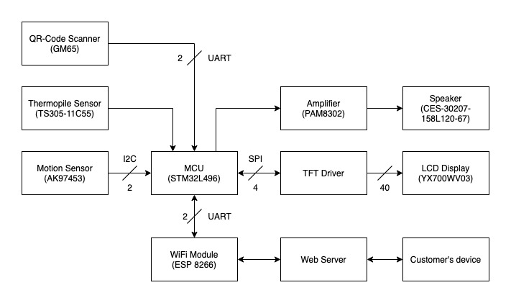
BLOCK DIAGRAM

Slide 6
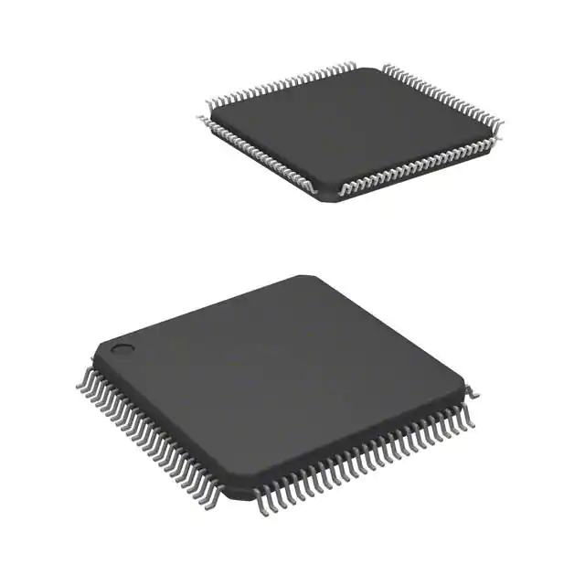
Major Components
Microcontroller
STM32L476VGT7
Functionality:
Performs station computing tasks, receives
all sensor data, sends information to web
server
Specifications:
Flash Size - 1 MB
RAM Size - 128 KB
I/O Pins - 82
Current in Run Mode - 100 uA/MHz
Frequency - 80 MHz
Operating Temperature - -40°C - 105°C

Slide 7
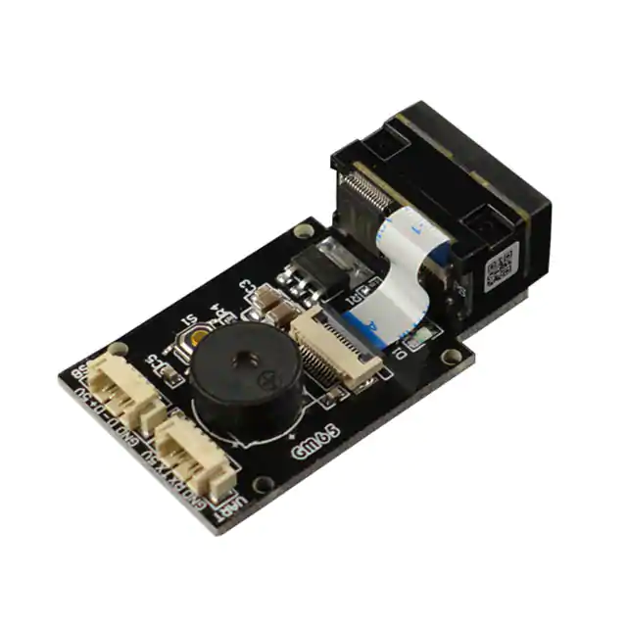
Major Components
QR Code Scanner
GM65
Functionality:
Scan the QR code and parse the data
into the MCU
Specifications:
Operating voltage - 5V
Operating Current - 120mA
Operating Temperature - 0°C - 50°C

Slide 8
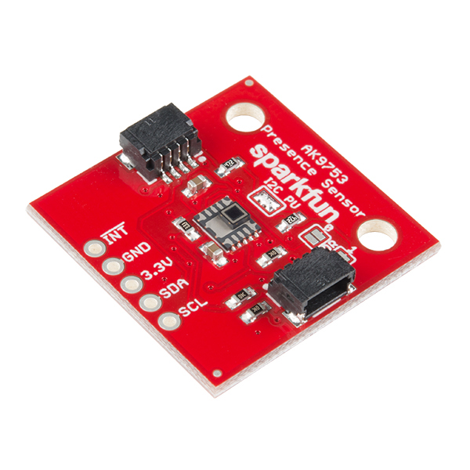
Major Components
PIR Sensor
AK9753 Human Presence Sensor
Functionality:
Detects customer motion by reading the
output current data from 4 IR sensors
Specifications:
Operating Voltage - 3.3V - 3.6V
Operating Current - 100 uA
Operating Temperature - -30°C - 85°C
Sensitivity Range - <3m

Slide 9
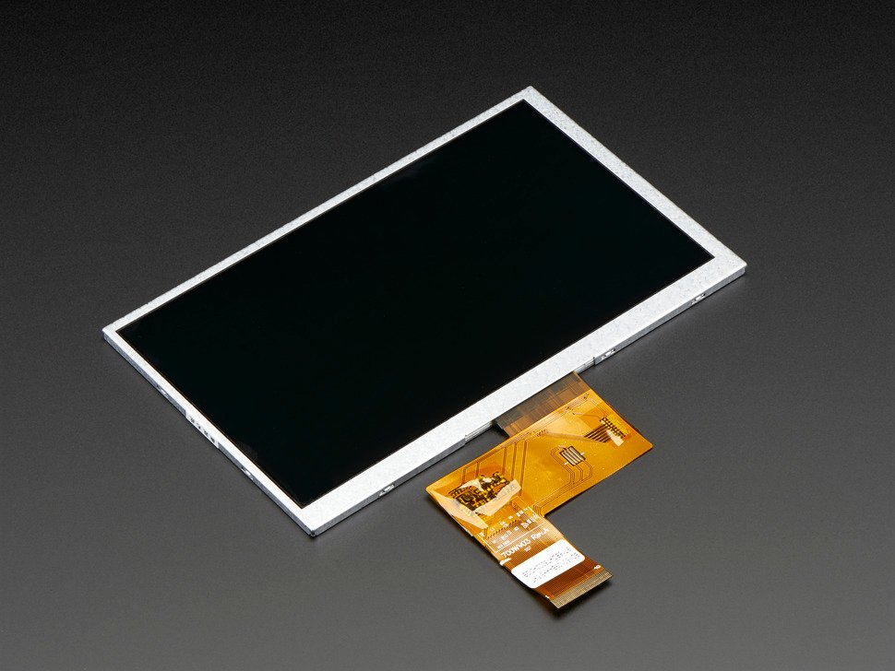
Major Components
LCD Display
Adafruit 7.0” 40-pin TFT Display
Functionality:
Display queue information to
customers
Specifications:
Input pins - 40 pins
Dimensions - 154.08 mm x 85.92 mm
Operating Voltage - 9.3V - 10.5V
Operating Current - 125-150 mA
Operating Temperature - -20°C - 70°C

Slide 10
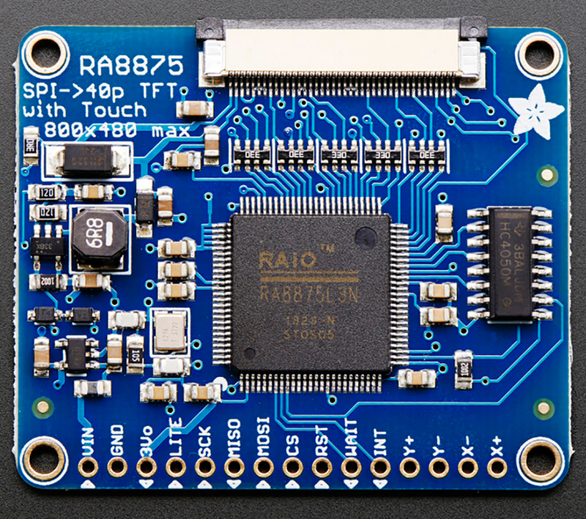
Major Components
LCD Display Driver
RA8875 Driver Board
Functionality:
Allow the MCU to communicate with the
display via SPI interfaces
Specifications:
Operating Voltage - 3.0V - 3.6V
Power Dissipation - <= 150mW
Operating Temperature - -30°C - 85°C

Slide 11
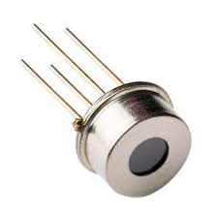
Major Components
Thermopile
TS305-11C55
Functionality:
Take customer temperature by changing
resistance based on infrared radiation
Specifications:
Sensing Temperature - 0°C - 100°C
Temp. Coefficient of Resistance - -0.06%/°K
Field of View - 88°
Operating Temperature - -20°C - 85°C

Slide 12
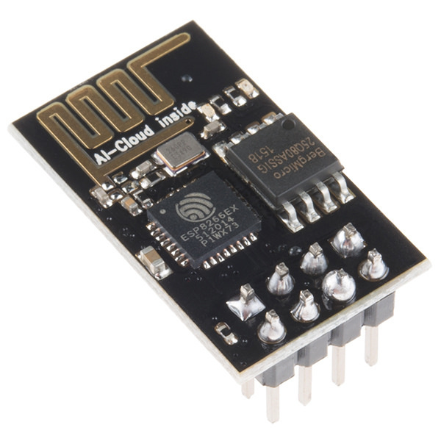
Major Components
WiFi Module
ESP8266
Functionality:
Communicates with the web server to
receive and send information about the
queue, barcode scans, and people
entering and exiting.
Specifications:
WiFi protocol - 802.11 b/g/n
Protocol - UART
Operating Current - 80 mA
Operating Temperature - -20°C - 100°C

Slide 13
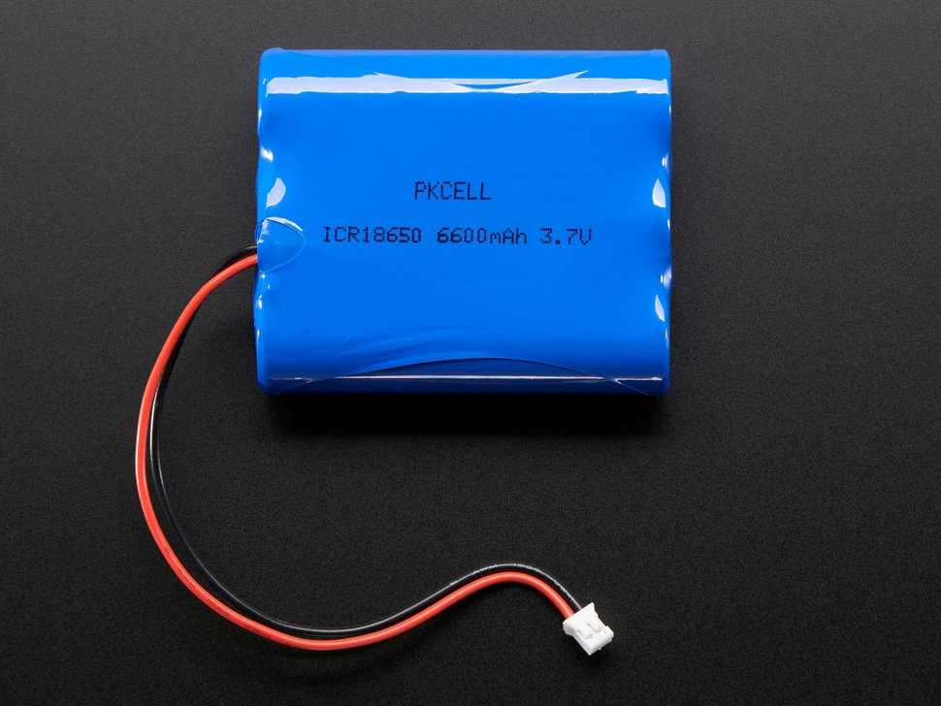
Major Components
Battery
Lithium Ion Battery Pack (ICR18650)
Functionality:
Provide a rechargeable power source
Specifications:
Voltage - 3.7V
Charging Cut-off - 4.2V
Discharge Cut-off - 3.0V
Typical Capacity - 6600 mAh @ 20°C
Low Temp. Capacity - 3960 mAh @ -10°C
Discharge Temperature - -20°C - 70°C
Recommended Continuous Discharge Current - < 1.3 A

Slide 14
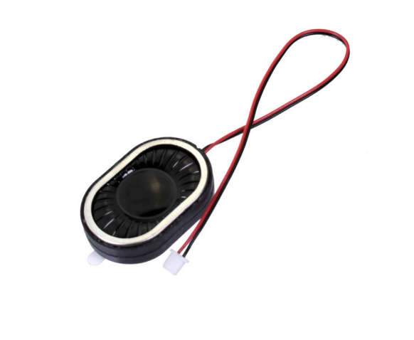
Major Components
Speaker
CES-30207-158L120-67
Functionality:
Outputs the sound the MCU receives from the web server of the employee inside the store.
Specifications:
Input power - 1.5W
Max Input power - 2W
Sound pressure level - 100dB
IP level - IP67
Impedance at 1kHz - 8Ω
Operating Temperature - -40°C - 80°C

Slide 15
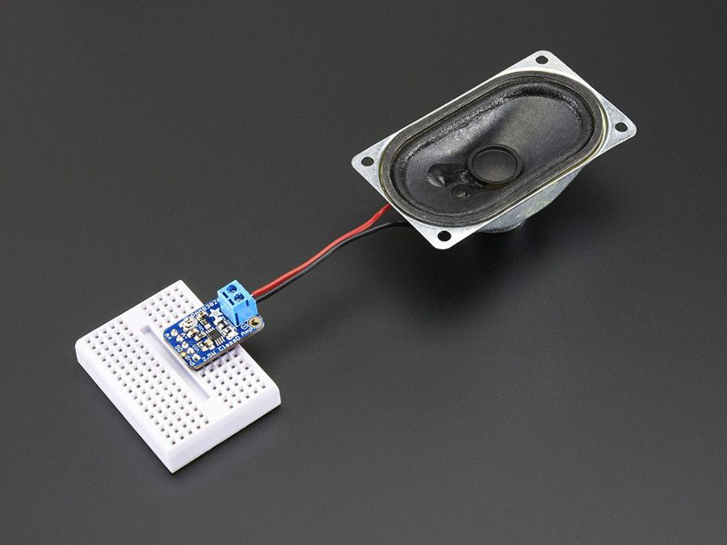
Major Components
Audio Amplifier
PAM8302
Functionality:
Amplify the signal from the MCU and output it to the speaker.
Specifications:
Supply voltage range - 2 to 5.5V
Output power - 1.5W
Quiescent Current - 4mA
Operating temperature - -40°C to 85°C

Slide 16
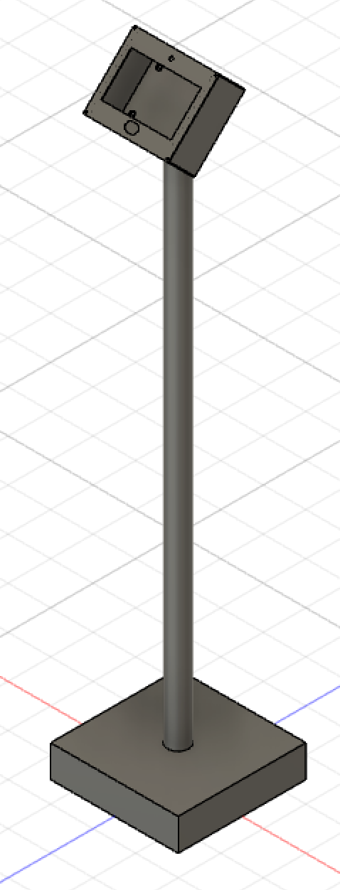
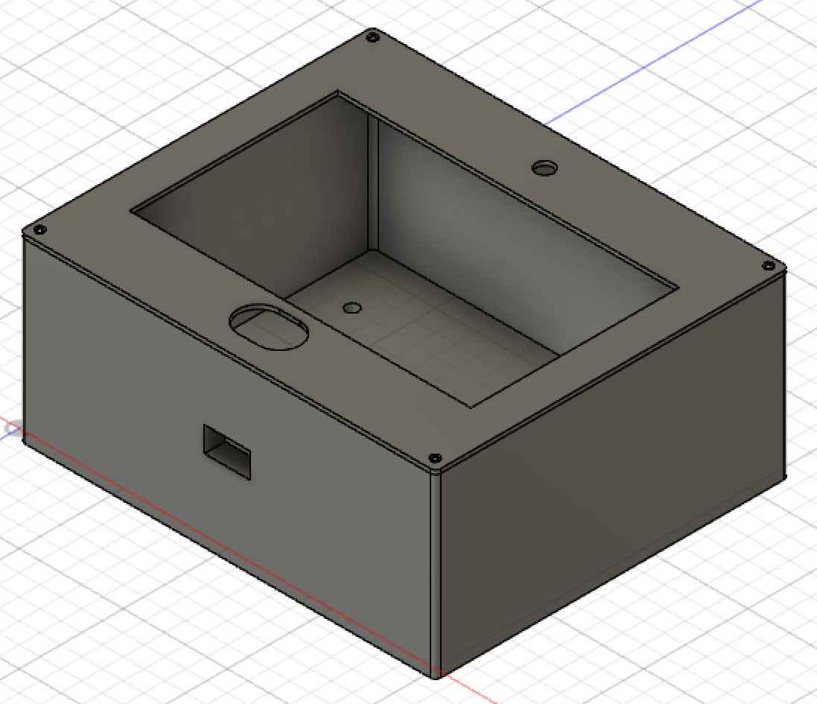
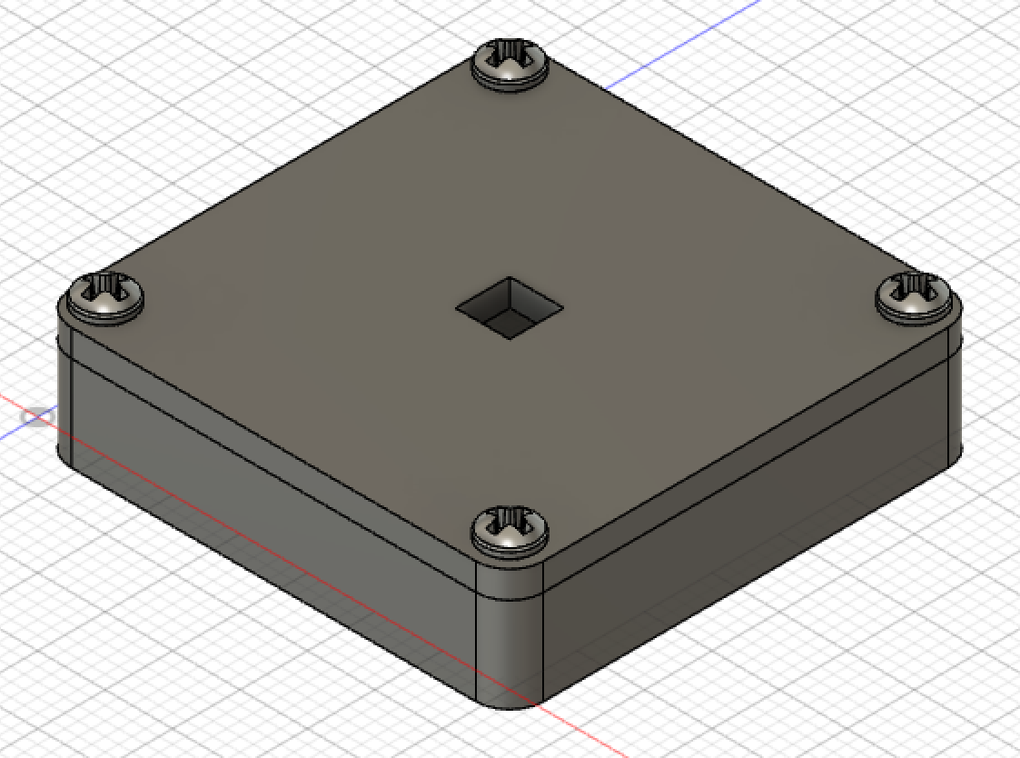
PACKAGING DESIGN
Stand
1.65 m tall
PVC pipe in wooden base
Main Box
Laser-cut ABS plastic
20 cm x 170 cm x 85 cm
Everything but PIR
Door Sensor Box
3D-printed PLA plastic
3.5 cm x 3.5 cm x 1 cm
PIR housing for best placement for business
Main Box
Door Sensor Box
Base Station - Main Box + Stand

Slide 17
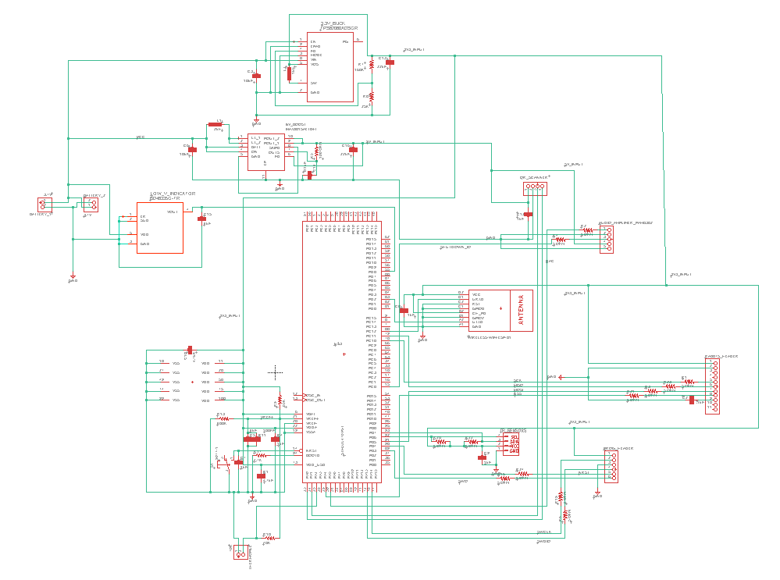
ELECTRICAL SCHEMATIC
Entire Circuit

Slide 18
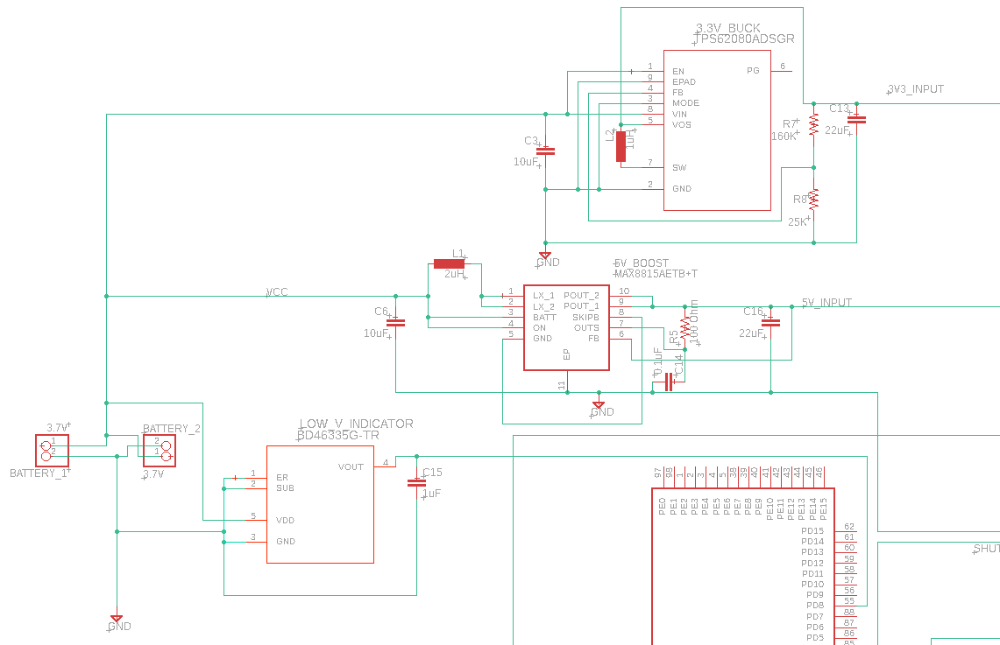
ELECTRICAL SCHEMATIC
Low Battery and Boost/Buck Converter Circuitry

Slide 19
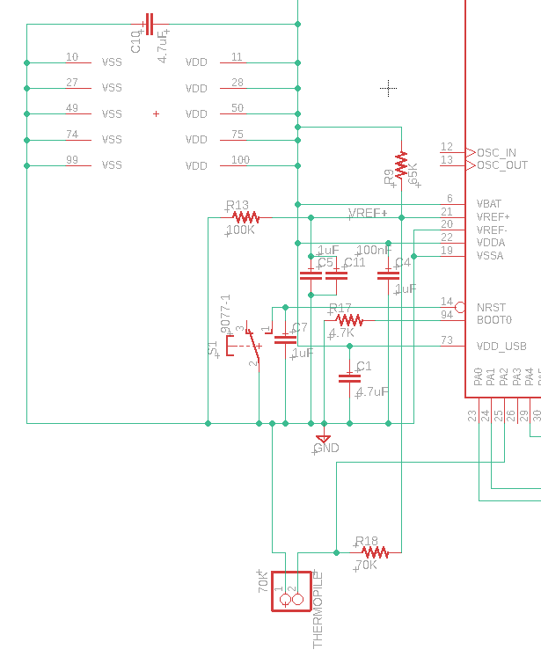
ELECTRICAL SCHEMATIC
Decoupling Capacitor/Reset Circuitry

Slide 20
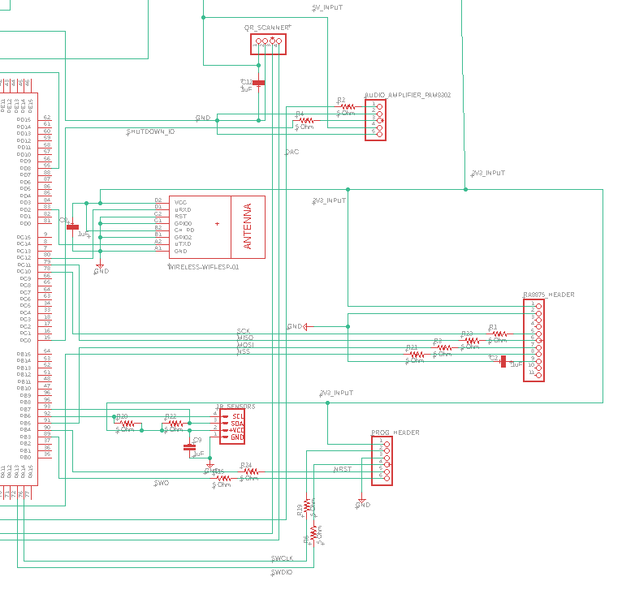
ELECTRICAL SCHEMATIC
Module Circuitry

Slide 21
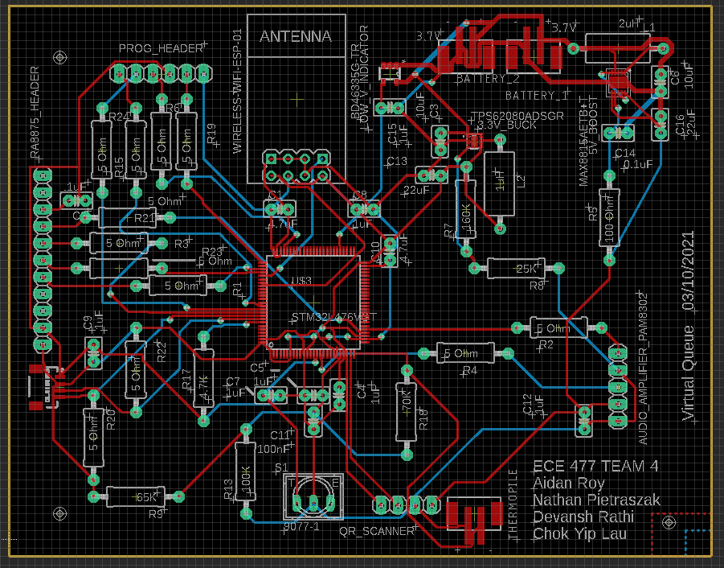
PCB LAYOUT
Overview

Slide 22
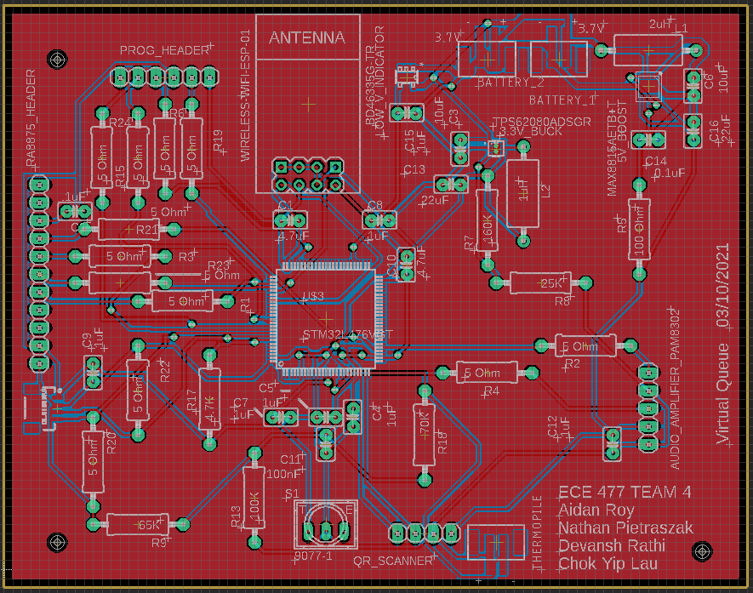
PCB LAYOUT
Copper Pour View

Slide 23
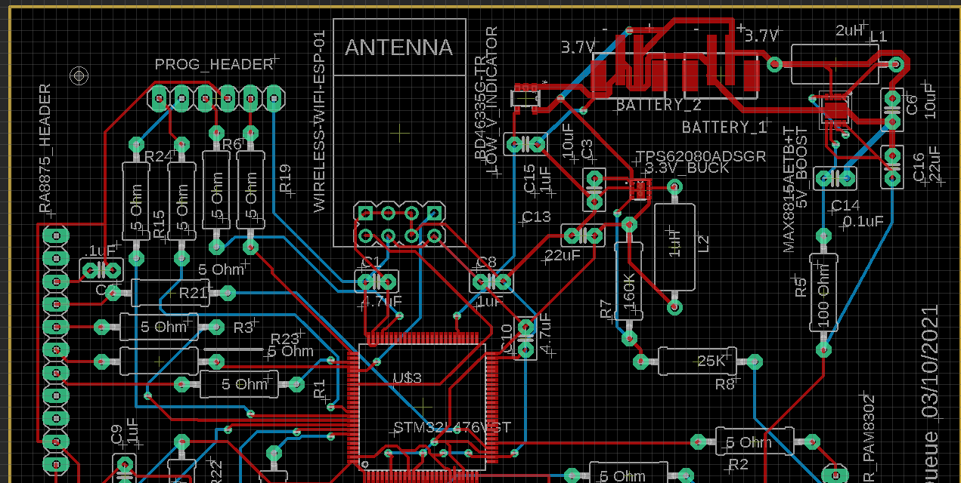
PCB LAYOUT
Top Half

Slide 24
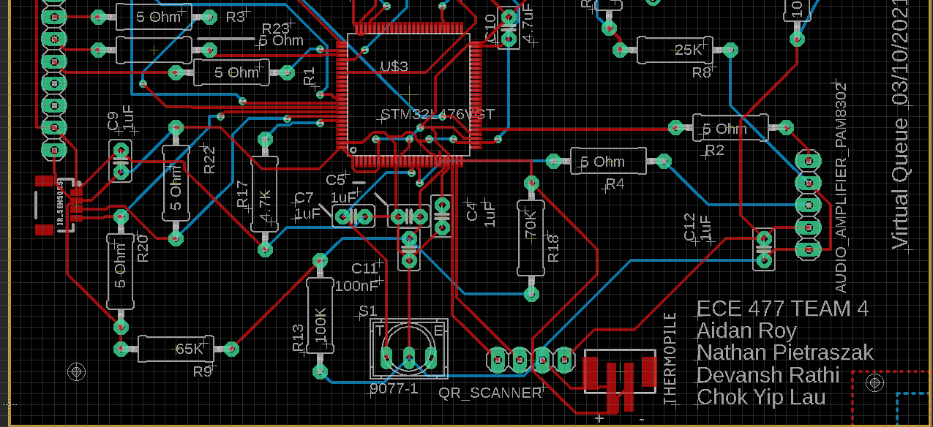
PCB LAYOUT
Bottom Half

Slide 25
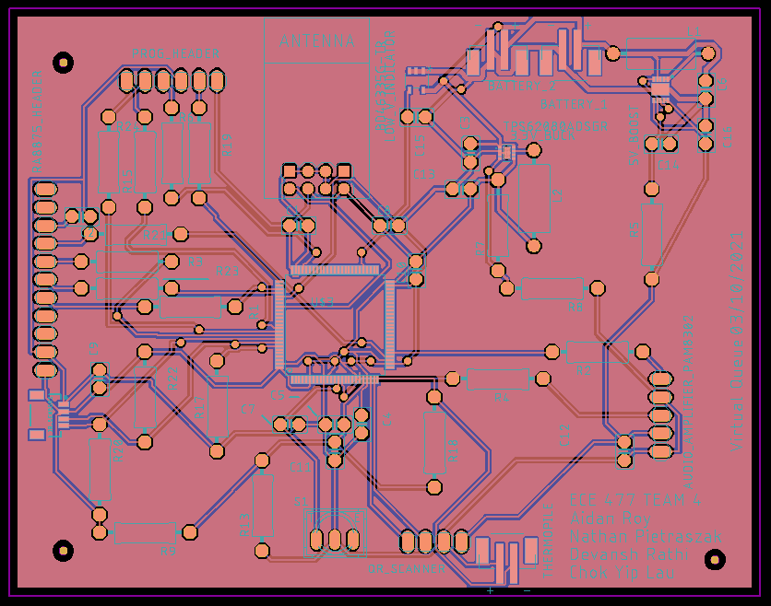
PCB LAYOUT
Gerber View

Slide 26
PROTOTYPING PROGRESS
Sensor Connectivity
Tested & Proven:
WiFi module
send and receive commands via UART
Thermopile
read output voltage via ADC
PIR sensor
read data over I2C
Untested/Unproven:
QR scanner
working on UART connection
Display + Driver
scheduled to begin SPI connection
Speaker + Amplifier
scheduled to begin DAC connection

Slide 27
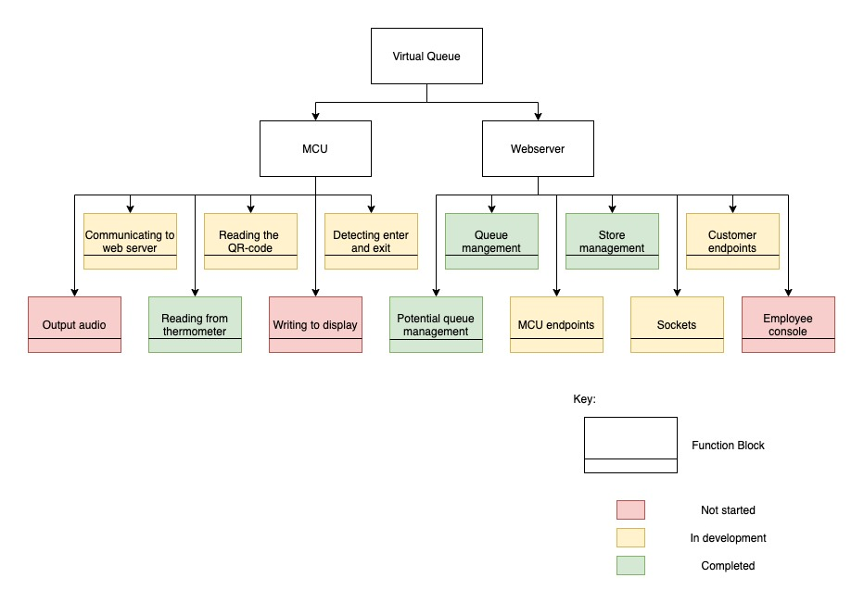
SOFTWARE DEVELOPMENT STATUS

Slide 28
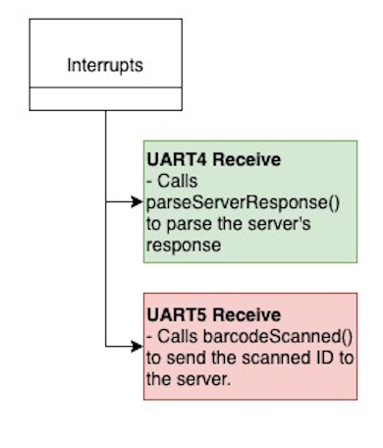
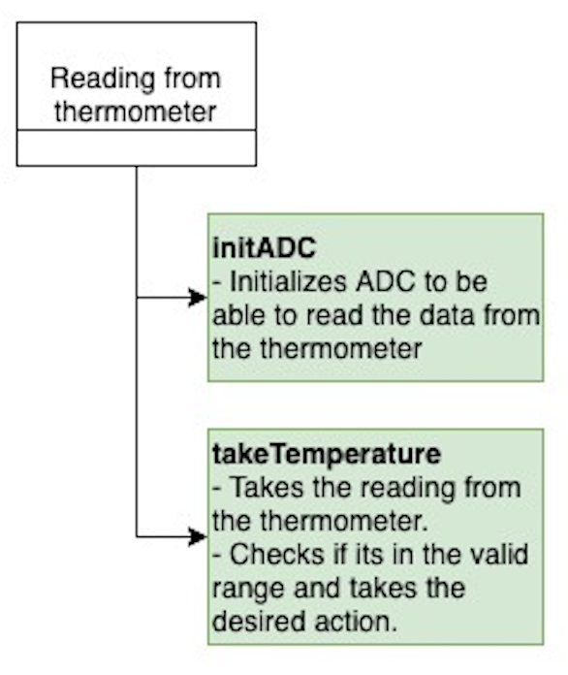
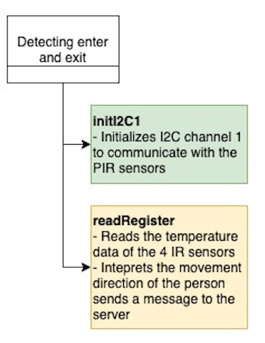
SOFTWARE DEVELOPMENT STATUS

Slide 29
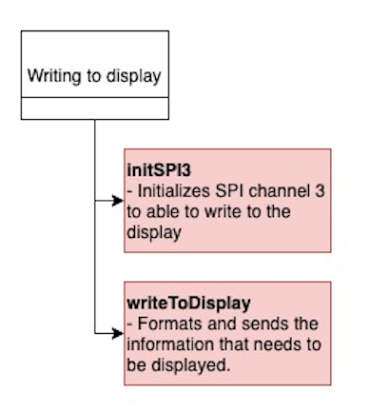
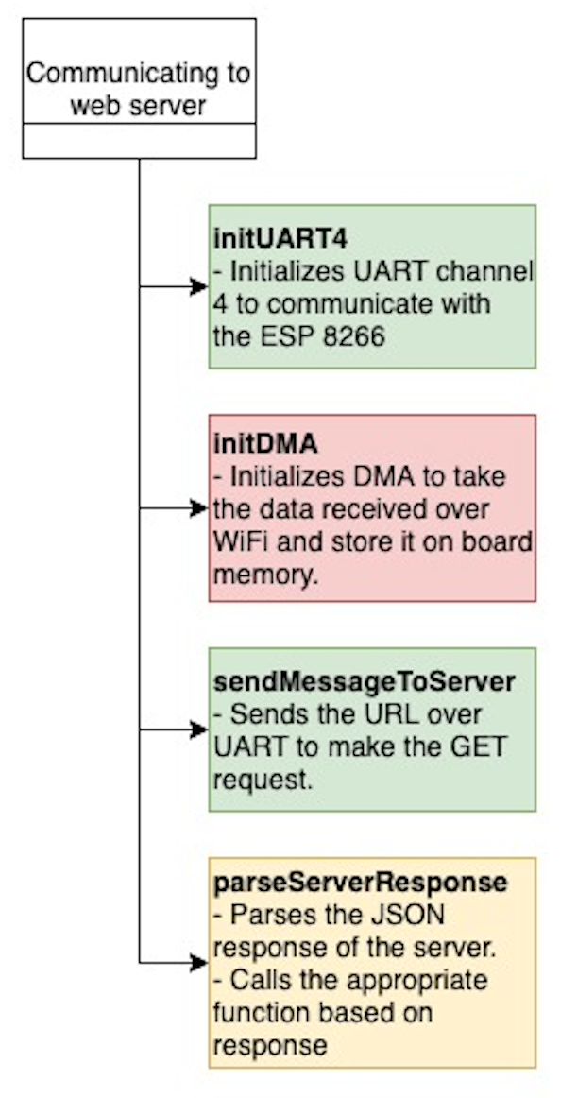
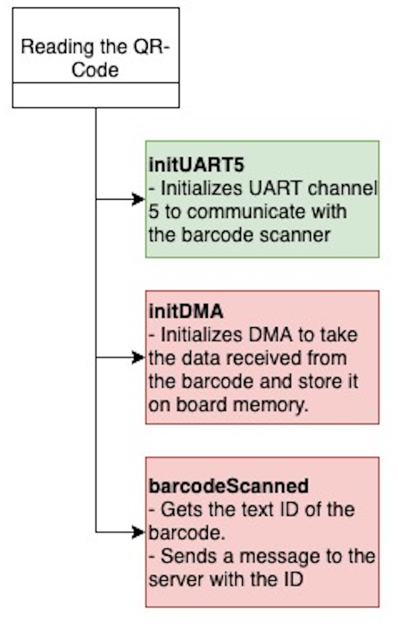
SOFTWARE DEVELOPMENT STATUS

Slide 30
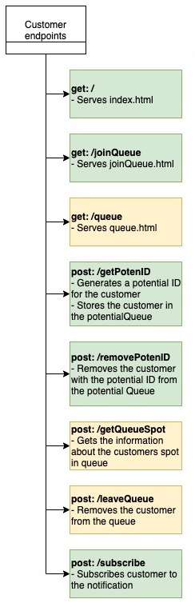
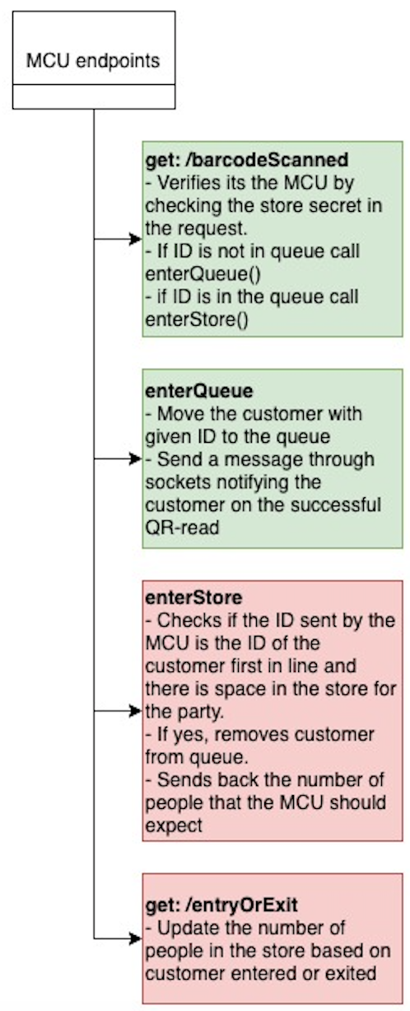
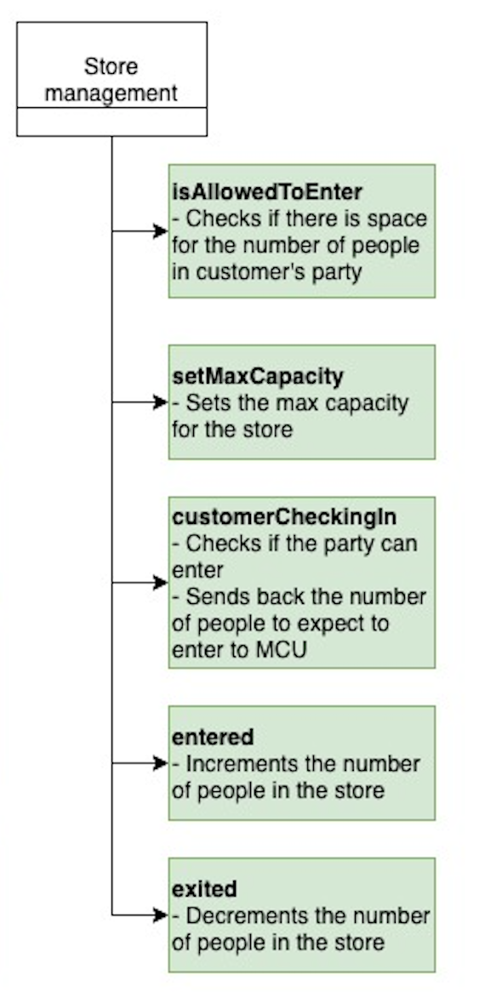
SOFTWARE DEVELOPMENT STATUS

Slide 31
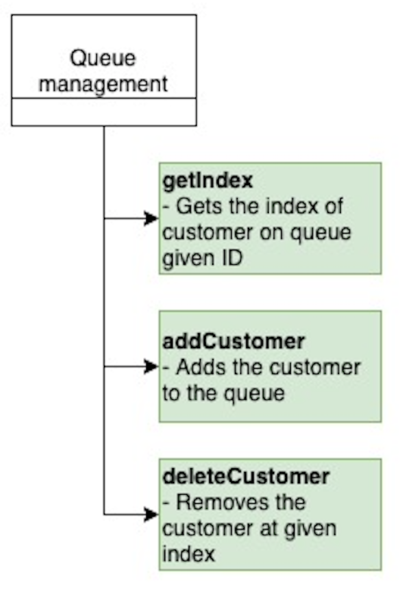
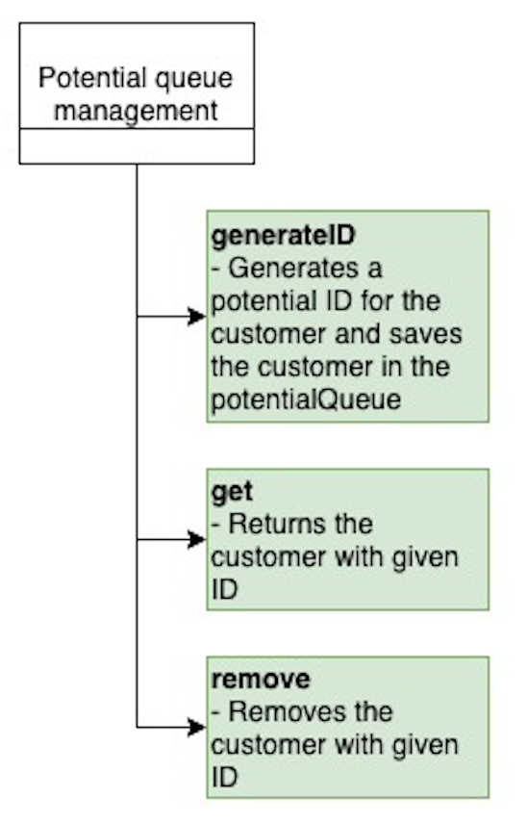
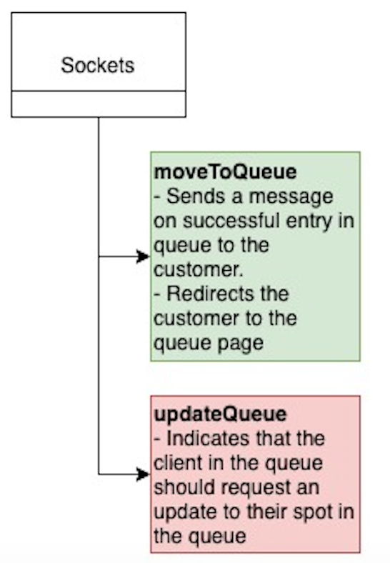
SOFTWARE DEVELOPMENT STATUS

Slide 32
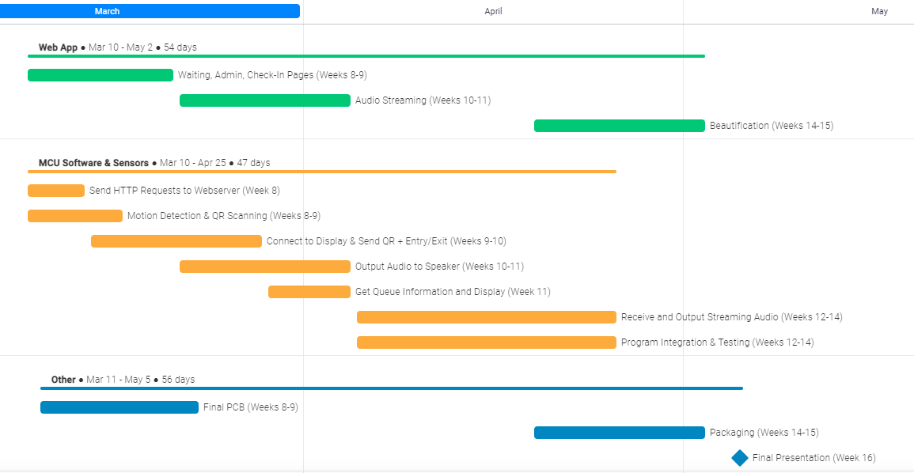
PROJECT TIMELINE

Slide 33
3D PRINTING
Questions?

